Slide 1
WEBER COUNTY SHERIFF’S OFFICE MARRIOTT-SLATERVILLE
2013 QUARTERLY REPORT

Slide 2
CALL BREAKDOWN
 |  | REPORTS
CALL DESCRIPTION | TOTAL |  | CALL DESCRIPTION | TOTAL
911 calls | 1 |  | Motorists assists | 4
Alarms | 3 |  | Parking problems | 1
Animal complaints | 9 |  | Premise checks | 27
Assaults | 0 |  | Property damage | 1
Assault on police officer | 1 |  | Reckless driver | 1
Assist fire department | 1 |  | Sex offenses | 0
Assist other jurisdictions | 1 |  | Stolen vehicle | 1
Burglaries | 2 |  | Stolen trailer | 1
Citizen assists | 3 |  | Suspicious activity | 5
Civil disputes | 4 |  | Thefts | 0
Community policing | 17 |  | Traffic hazards | 3
Criminal mischief | 1 |  | Traffic offense | 1
Disturbance – family | 1 |  | Traffic accidents property | 12
Drug violations | 1 |  | Traffic accidents injury | 0
Extra patrol | 1 |  | Traffic stops | 48
Frauds | 0 |  | Vehicle burglaries | 2
Keep the peace | 3 |  | Warrants | 3
Medicals | 1
JANUARY
229 CALLS
Priority 1 – 72
Priority 2 – 15
Priority 3 – 58
Priority 4 – 75
Priority 5 – 0
Priority 6 - 9

Slide 3
CALLS FOR SERVICE 5-YEAR COMPARISON
TOTAL CALLS
2009 216
2010 180
2011 227
2012 211
2013 229

Slide 4
1100 West Burglaries
Between the 18th and 20th, several crimes took place at numerous businesses along 1100 West. The suspects cut through chain-link fences to gain access to the lots. One suspect was captured on surveillance video but has yet to be identified.
Burglary – Lost Recovery 1668 S. 1100 W. Back fence is cut. One vehicle is stolen. Two motorhomes, five trailers, and six cars are burglarized.
Burglary – Bottom Line Sales 1636 S. 1100 W. Fence cut. Trailers burglarized.
Criminal mischief – Fences cut at 1554 S. 1100 W.
Criminal mischief – Fences cut at 1636 S. 1100 W.

Slide 5
1100 W 17th Street

Slide 6
ASSAULT ON A POLICE OFFICER
On 01/14/2013 Deputy Lavely and Sgt. Butler responded to a residence on west 17th Street to deal with a suicidal subject. The male ended up fighting with deputies and was subdued by a Taser. After the suspect was secured, it was discovered all the burners on the stove were turned on, filling the house with gas. It appears the suspect may have been planning to kill himself by blowing up the residence.

Slide 7
CALL BREAKDOWN
 |  | REPORTS
CALL DESCRIPTION | TOTAL |  | CALL DESCRIPTION | TOTAL
Abandoned vehicles | 2 |  | Parking problems | 1
Alarms | 0 |  | Police assistance | 1
Animal complaints | 9 |  | Premise checks | 17
Assaults | 0 |  | Property damage | 0
Assist other jurisdictions | 1 |  | Sex offenses | 0
Burglaries | 1 |  | Stolen vehicle | 0
Citizen assists | 5 |  | Suspicious activity | 5
Civil disputes | 1 |  | Telephone harassment | 1
Community policing | 14 |  | Thefts | 2
Criminal mischief | 1 |  | Threatened suicide | 1
Disorderly conduct | 1 |  | Traffic hazards | 4
Disturbance – family | 0 |  | Traffic accidents property | 8
Drug violations | 0 |  | Traffic accidents injury | 1
DUIs | 1 |  | Traffic stops | 123
Frauds | 0 |  | Vehicle burglaries | 3
Keep the peace | 2 |  | Warrants | 0
Medicals | 4 |  | Welfare check | 1
Motorists assist | 1
FEBRUARY
250 calls
Priority 1 – 145
Priority 2 – 10
Priority 3 – 32
Priority 4 – 60
Priority 5 – 0
Priority 6 - 3

Slide 8
CALLS FOR SERVICE 5-YEAR COMPARISON
TOTAL CALLS
2009 138
2010 159
2011 202
2012 237
2013 250

Slide 9
RANDOM PROPERTY CRIMES
02/06 – Theft 1615 S. 1100 W. Fugal Construction. Holes cut in fence. Construction trucks burglarized.
02/07 – Vehicle burglary. 1401 W. 200 S. Tools stolen from bed of truck.
02/18 – Theft 1181 W. 12th St. Beer run at 7-11 at 0220 hours.
02/15 – Theft 1155 S. 1700 W. Hole drilled in gas tank of U-Haul truck at the Sleep Inn.
02/15 – Vehicle burglary 1751 W. 12th St. Big Bubba’s. Saddles and gear stolen from horse trailer.
02/26 – Theft 1350 S. 1200 W. Rocky Mt. Power. 50 feet copper wire stolen from sub-station.

Slide 10
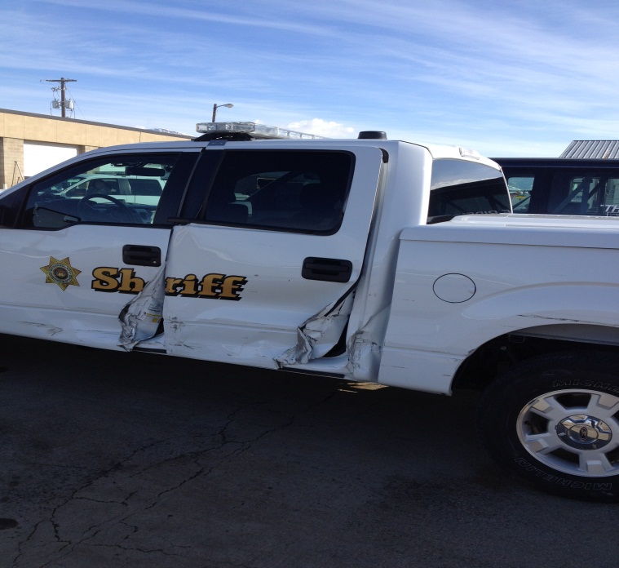
TRAFFIC ACCIDENTS
JANUARY
12 PD
0 PI
FEBRUARY
8 PD
1 Pi
Sheriff’s Office
7

Slide 11
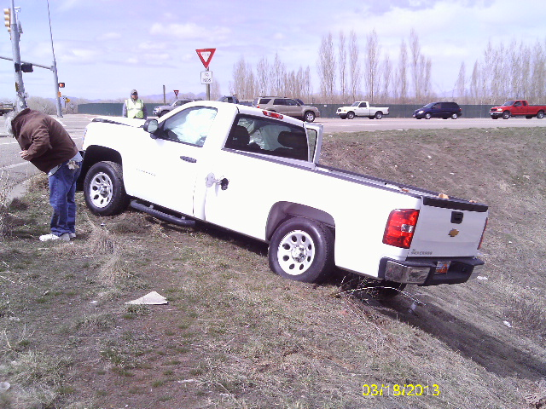
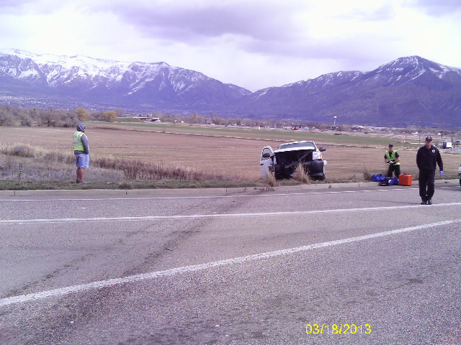
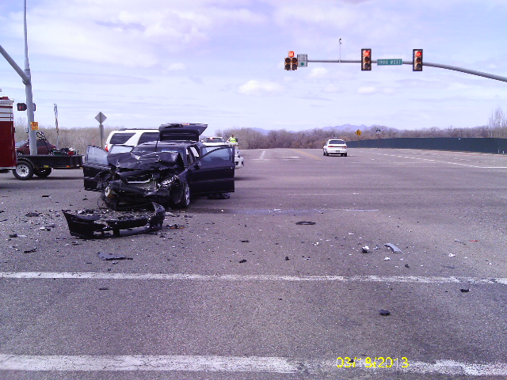
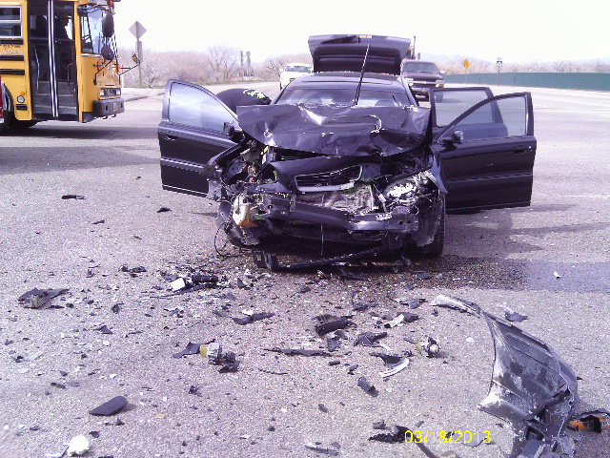
Multiple ACCIDENTS = Multiple RESPONSES
03/18/2013
1229 hours
1900 W. 12th St.
4 deputies
1237 hours
1300 W. 12th St.
3 deputies
1238 hours
1670 W. 12th St.
3 deputies

Slide 12
CALLS FOR SERVICE 5-year Comparison
TOTAL CALLS
2008 2479
2009 2466
2010 2580
2011 2781
2012 2400

Slide 13
CITATIONS 5-YEAR COMPARISON

Slide 14
CITATIONS 5-YEAR COMPARISON

Slide 15
2012 DUI ARRESTS

Slide 16
CRIME PATTERNS AND CONCERNS
Overall, call volume has increased slightly the first two months of 2013. This is not due to an increase in crime but rather an increase in community-oriented policing efforts which include school visits and business checks.
Overall, violent crime and property crime rates remain relatively low. Most property crimes have been occurring in the southeast area of the city along 12th Street and 17th Street.
An increase in temperature usually correlates with an increase property crimes.
A crime prevention letter will be sent out with the city newsletter reminding residents to always lock their vehicles and to never leave valuables inside.
Deputies will increase patrol in problem areas and continue to conduct more security checks and foot patrols.

Slide 17
COMMUNITY POLICING
Crime prevention letter to be mailed out with city newsletter.

Slide 18
SCHOOL VISITS
PIONEER Elementary
Jan - 14
Feb – 13
VENTURE ACADEMY
Jan – 2
Feb - 5
WELCOME SCHOOL RESOURCE
OFFICER MIKE CHATELAIN!

Slide 19
PREMISES CHECKS
JANUARY
27
February
17

Slide 20
TOWNHOUSE ESTATES
 | 2008 | 2009 | 2010 | 2011 | 2012
Calls | 56 | 61 | 81 | 104 | 101
Total MSL calls | 2479 | 2466 | 2580 | 2781 | 2400
% of total MSL calls | 2.3% | 2.5% | 3.1% | 3.7% | 4.2%

Slide 21
PRIORITY CALLS
YEAR | Priority 1 & 2 | Priority 3 & 4 | Priority 5 & 6 | Total Calls
2008 | 31 | 23 | 2 | 56
2009 | 27 | 28 | 6 | 61
2010 | 23 | 47 | 11 | 81
2011 | 33 | 56 | 15 | 104
2012 | 40 | 56 | 5 | 101

Slide 22
BREAKDOWN
COMPLEX | Calls | Total City Calls | % of Total Calls
Townhouse Estates | 104 | 2781 | 3.7%
Haven Pointe | 456 | 7143 | 6.4%
Settlers Landing | 191 | 7143 | 2.7%
COMPLEX | Units | Est. Tenants | 2011 City Pop.
Townhouse Estates | 50 | 150 | 1708
Haven Pointe | 191 | 650 | 10415
Settlers Landing | 276 | 750 | 10415
 | Calls Per Capita
West Haven | 0.69
Marriott-Slaterville | 1.63
Townhouse Estates | 0.69
Haven Pointe | 0.7
Settlers Landing | 0.26

Slide 23
CALLS PER CAPITA

Slide 24
ANALYSIS
Call volume has nearly doubled over a five-year period of time (56 to 101). A 45% increase.
In 2008, the complex accounted for 2.3% of the total calls in Marriott-Slaterville City. That percentage has steadily increased over the past five years, with the total being 4.2% in 2012.
Priority 1 & 2 calls decreased between 2008 to 2010 but have increased from 2010 to 2012.
Priority 3 & 4 calls have gradually increased from 2008 to 2012. The total has more than doubled during this five-year period of time (23 to 56).
Marriott-Slaterville has the highest average of calls per capita (1.63) versus West Haven (0.69).
Townhouse Estates and Haven Point Apartments have similar calls per capita (0.69 versus 0.70), versus Settlers Landing (0.26).

Slide 25
SOLUTIONS
The property owners and managers work together with the City and the Sheriff’s Office to reduce crime and evict problem tenants.
The City implements a Good Land Lord Program to reduce crime. The program offers incentives to property owners who are in compliance. The program is regulated through business licensing. The Sheriff’s Office assists in gathering information and working together with the City.

Slide 26
QUESTIONS?

